Slide 1
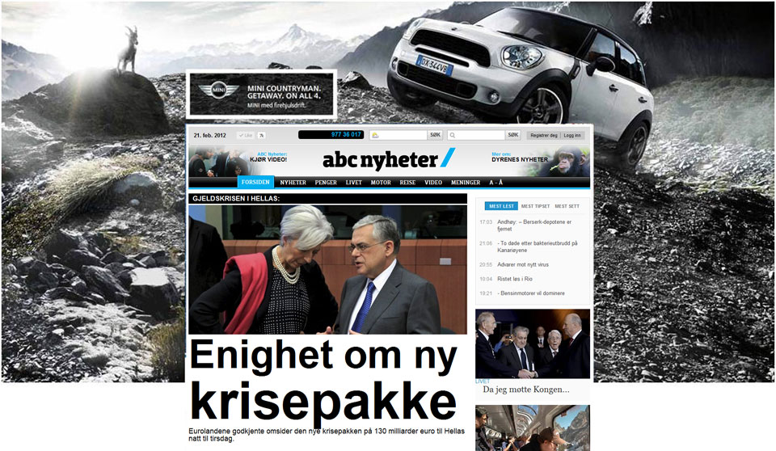
FORMAT WALLPAPER
1920x800(1000) jpeg/gif + 980x300 (150-200)html/gif
KB: 100+100

Slide 2
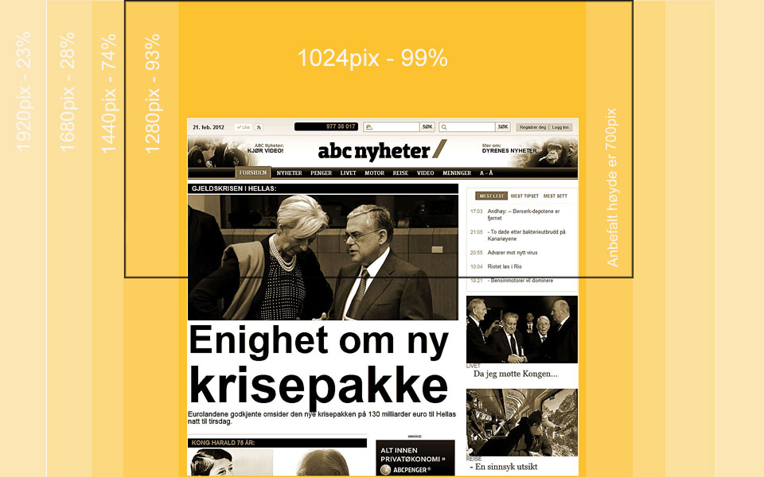
Screen resolution desktop ABCnyheter 2017
Recomended hight is 700 pix

Slide 3
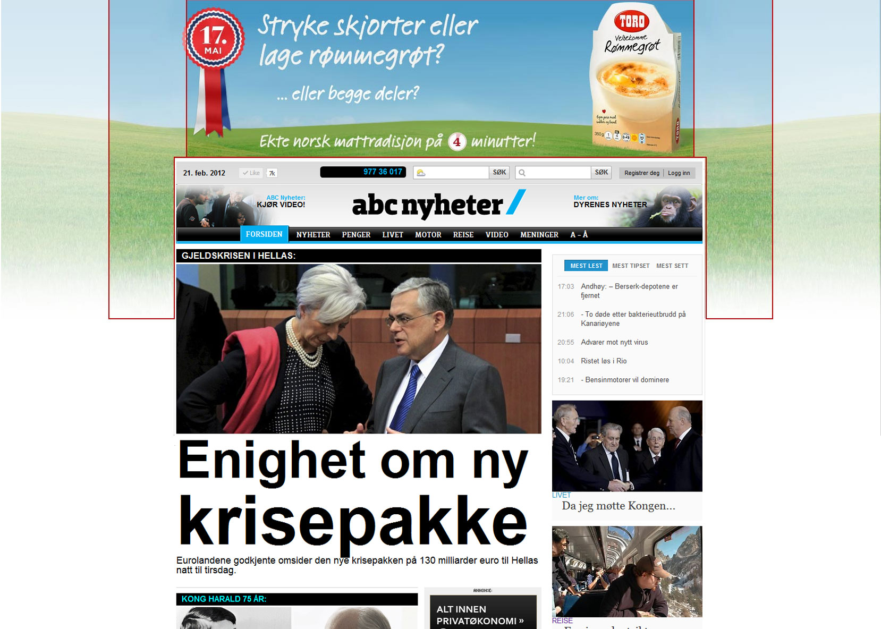
Best practice: The message is visible for all in the top banner and the picture behind enhance the dominance of the ad.

Slide 4
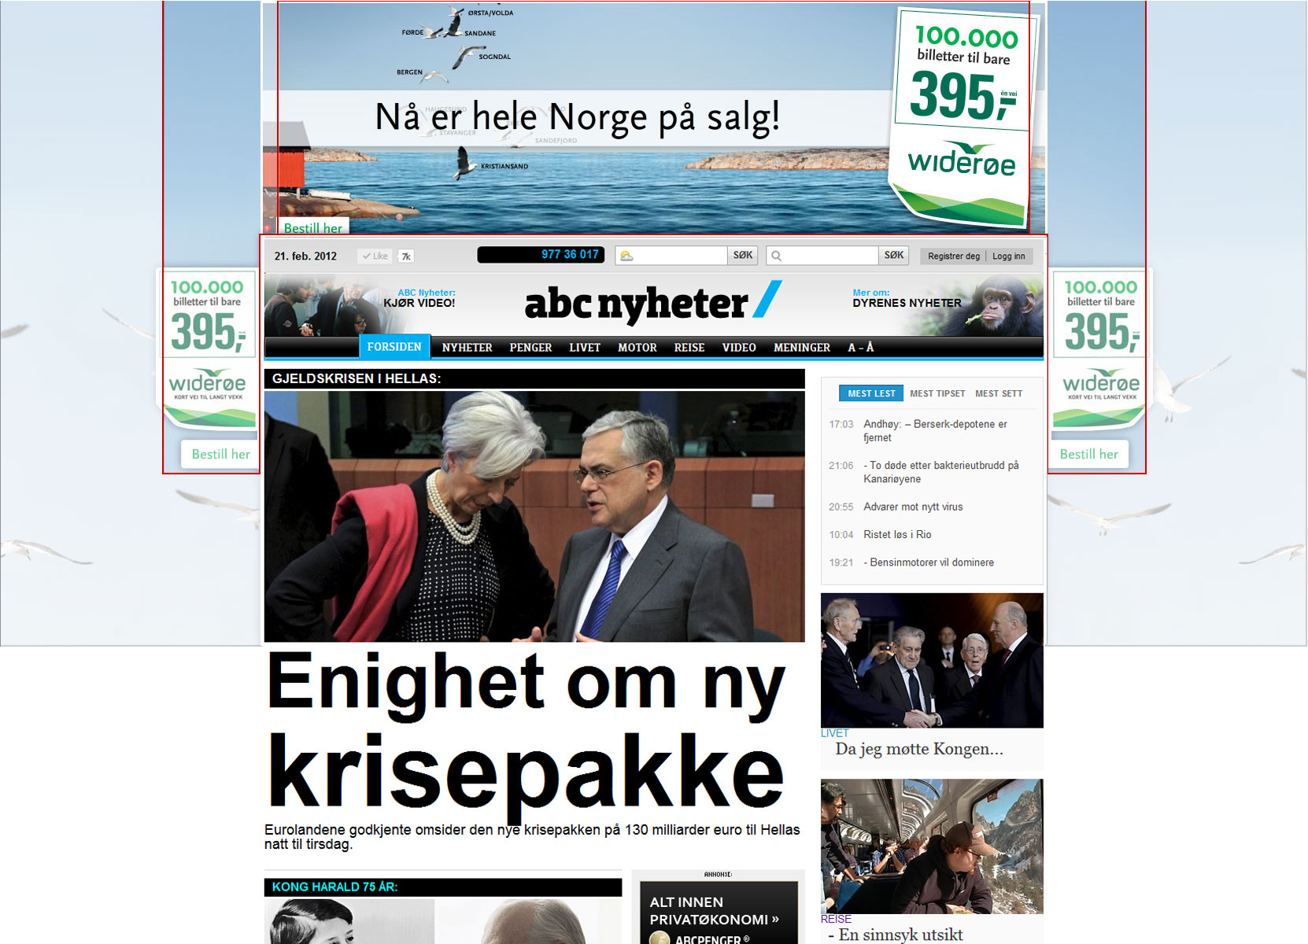
Best practice: Product and price is visible for all users and the message is enhanced by the repetition on both sides.

Slide 5
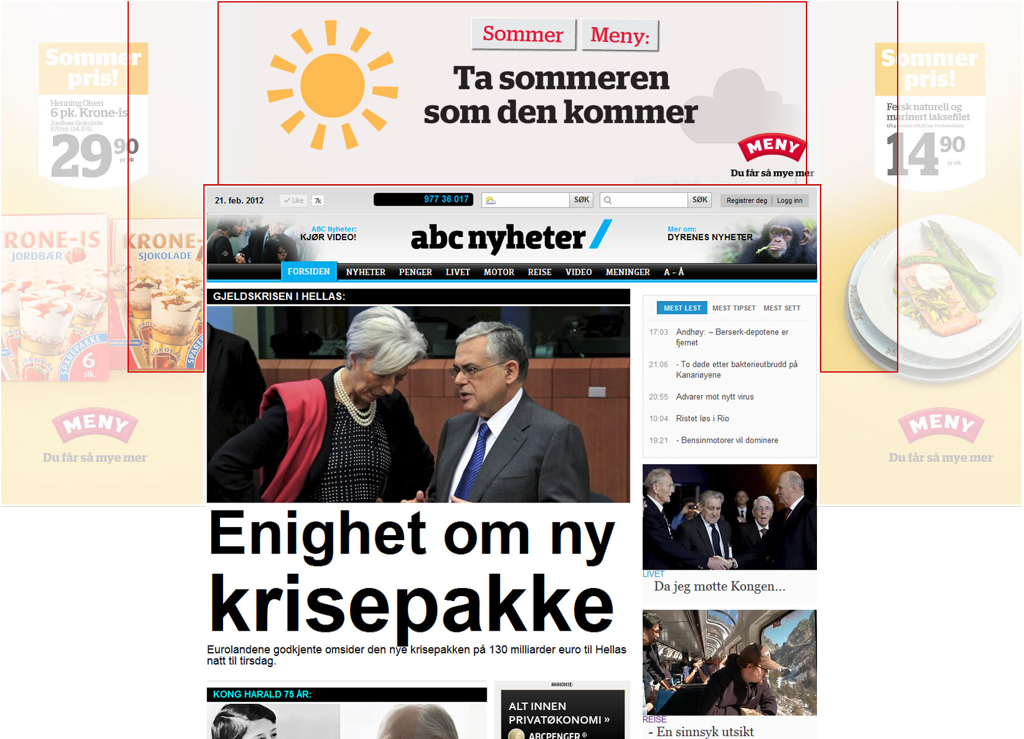
Wrong: Only 28% will be able to see product and price

